Slide 1
Multiplicative relationships
Understanding multiplicative relationships: fractions and ratio

Slide 2
how to use Oak lessons

Slide 3
I can calculate the multiplier for any two given numbers.

Slide 4
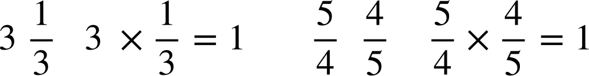
A reciprocal is the multiplicative inverse of any non-zero number. Any non-zero number multiplied by its reciprocal is equal to 1.
Example
The reciprocal of 3 is
Example
The reciprocal of is

Slide 5

Multiplicative relationships
Connecting numbers multiplicatively
Efficiently calculating a single multiplier

Slide 6
Connecting numbers multiplicatively
Any two numbers can be connected by an additive and a multiplicative relationship.
Can you find the missing number given the operation and find the relationships between these two numbers?
×
3
10
30
+
20

Slide 7
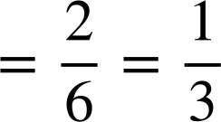
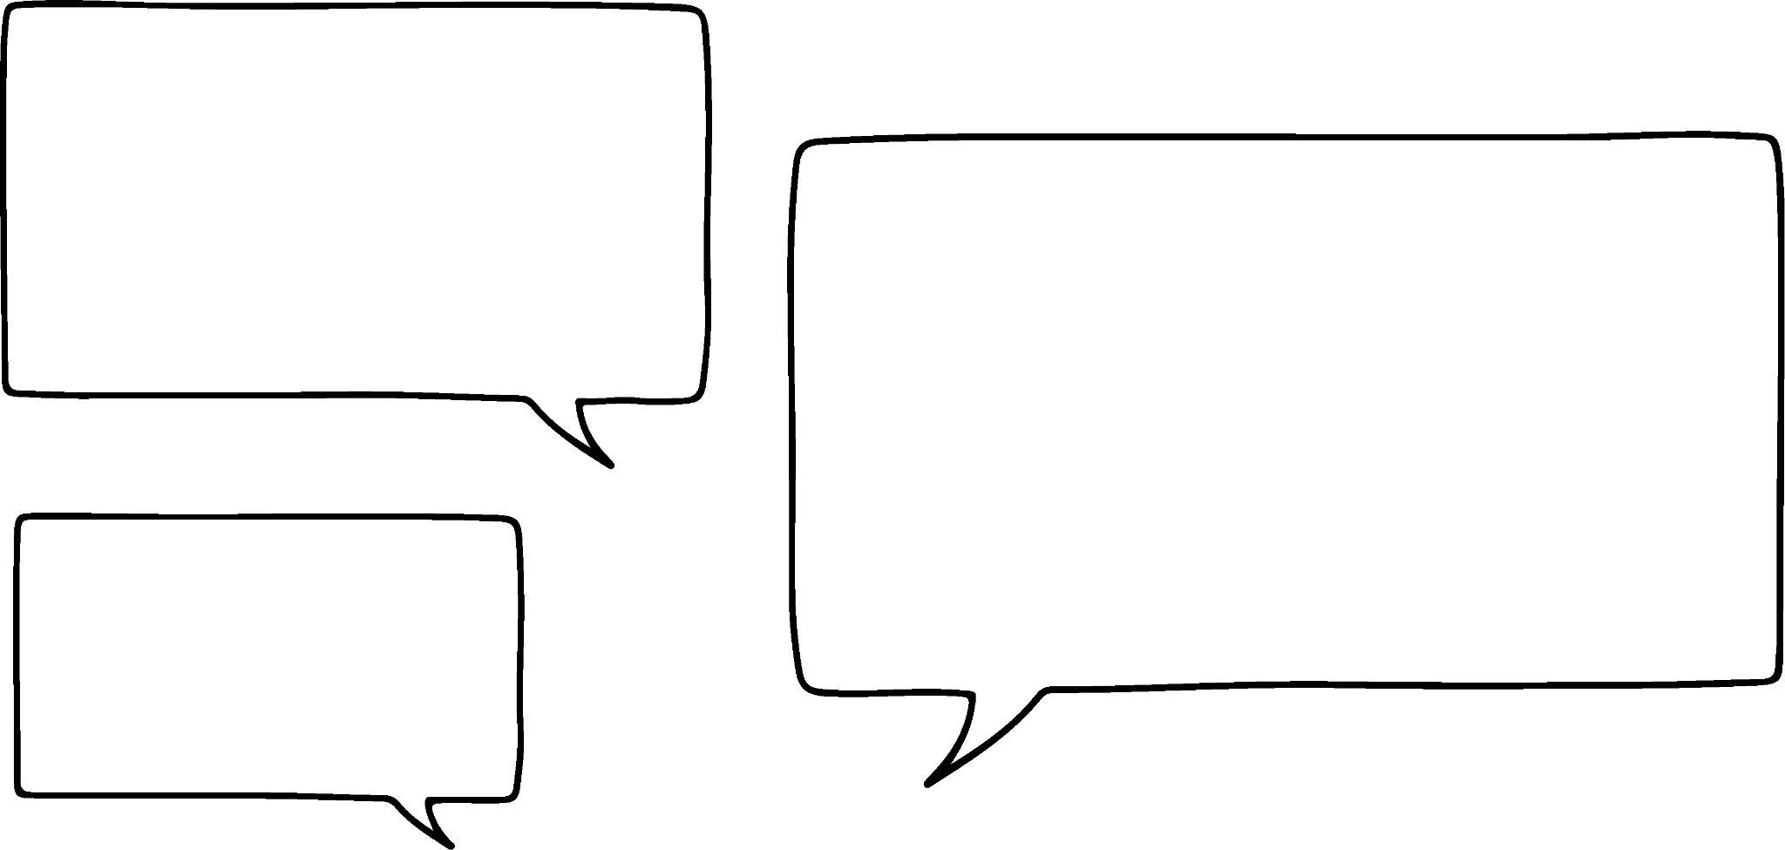

Connecting numbers multiplicatively
Three pupils were given this:
Is Laura correct? Explain.
×
6
2
There is no multiplicative relationship as they use division.
2 ÷ 6
There is a multiplicative relationship as dividing by 3 is the same as multiplying by

Slide 8
Connecting numbers multiplicatively
Work out the missing numbers, explaining how you found them.
×
×
a)
b)
3
9
12
24
+
+
×
×
c)
d)
4
28
6
3
+
+

Slide 9

Connecting numbers multiplicatively
9 ÷ 3
24 ÷ 12
×
3
×
2
a)
b)
3
9
12
24
6
12
+
+
9 - 3
24 - 12
28 ÷ 4
3 ÷ 6
×
7
×
c)
d)
4
28
6
3
24
+
+
28 - 4
(-3)
3 - 6

Slide 10
Connecting numbers multiplicatively
Using only addition and subtraction how can you connect these two numbers?
+ 2
6
8
You could do it in two steps.
6
8
− 3
3
+ 5

Slide 11
Connecting numbers multiplicatively
There are an infinite number of ways you can do this for any two numbers.
+ 2
6
8
− 7
− 1
+ 9
+ 2
6
8
+ 100
106
− 98
But these will all be equivalent to a single additive step.
In this case, plus 2.

Slide 12
Connecting numbers multiplicatively
Using only multiplication and division how can you connect these two numbers?
6
8
You could do it in two steps.
6
8
÷ 3
2
× 4

Slide 13
Connecting numbers multiplicatively
There are an infinite number of ways you can do this for any two numbers.
6
8
× 4
24
÷ 3
6
8
÷ 6
1
× 8
But these will all be equivalent to a single multiplicative step.

Slide 14




Connecting numbers multiplicatively
We can write the divisions as multiplications.
×
6
8
4 × =
and
× 8 = =
× 4
24
÷ 3
×
×
6
8
÷ 6
1
× 8
×
So the single multiplicative step is × but using two or more multiplicative steps may be easier when calculating mentally.

Slide 15
Connecting numbers multiplicatively
Complete each of these in two steps.
12
20
18
12

Slide 16


Connecting numbers multiplicatively
Complete each of these in two steps.
×
e.g.
12
20
÷ 6
2
× 10
×
18
12
÷ 3
6
× 2
There are lots of different ways, but check that they are equivalent to the single multiplier shown.

Slide 17

Connecting numbers multiplicatively
When working with proportional relationships, finding the multiplier in one direction makes it easy to work out the multiplier to go in the opposite direction.
× 2
× 4
5
10
3
12
÷ 2
×
÷ 4
×
5
10
3
12
Multiplying by the reciprocal is the inverse of the multiplier.

Slide 18
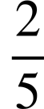
Connecting numbers multiplicatively
Use the given multipliers to work out the missing ones.
× 4
×
×
8
32
51
17
25
10
×
×
×
8
32
51
17
25
10

Slide 19

Connecting numbers multiplicatively
Use the given multipliers to work out the missing ones.
× 4
×
×
8
32
51
17
25
10
×
× 3
×
8
32
51
17
25
10

Slide 20
Connecting numbers multiplicatively
Work out the multipliers for the following pairs of numbers.
×
×
a)
8
16
d)
100
20
×
×
b)
3
15
e)
1.3
3.9
×
×
c)
1
7
f)
9
12

Slide 21
Connecting numbers multiplicatively
2) Fill in the table.
A | B | Multiplier A to B | Multiplier B to A
2 | 4
5 | 20
4 | 6
5 | 1
0.2 | 1.2

Slide 22
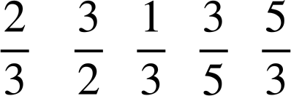
Connecting numbers multiplicatively
3) Fill in the missing numbers
×
×
3
4
a)
8
24
c)
23
92
×
×
24
8
92
23
×
×
d)
50
30
b)
15
10
×
×
30
50
10
15

Slide 23
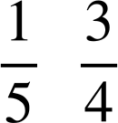
Connecting numbers multiplicatively
Work out the multipliers for the following pairs of numbers.
×
×
2
a)
8
16
d)
100
20
×
×
5
3
b)
3
15
e)
1.3
3.9
×
×
7
c)
1
7
f)
9
12

Slide 24
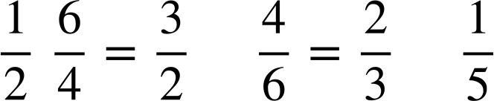
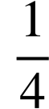
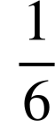
Connecting numbers multiplicatively
2) Fill in the table.
A | B | Multiplier A to B | Multiplier B to A
2 | 4
5 | 20
4 | 6
5 | 1
0.2 | 1.2
2
4
5
6

Slide 25
Connecting numbers multiplicatively
3) Fill in the missing multipliers.
×
×
3
4
a)
8
24
c)
23
92
×
×
24
8
92
23
×
×
d)
50
30
b)
15
10
×
×
30
50
10
15

Slide 26
Multiplicative relationships
Connecting numbers multiplicatively
Efficiently calculating a single multiplier

Slide 27
Efficiently calculating a single multiplier
You have looked at how the multiplier between two numbers can be found using multiple steps and combining them.
×
6
8
× 4
24
×
4 × =

Slide 28
Efficiently calculating a single multiplier
Using the middle value suggested, fill in the missing multipliers in each of the following:
a)
×
15
21
×
3
×
b)
×
8
3
×
1
×

Slide 29




Efficiently calculating a single multiplier
Using the middle value suggested, fill in the missing multipliers in each of the following:
a)
×
15
21
×
3
× 7
b)
×
8
3
×
1
× 3

Slide 30
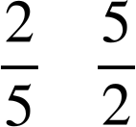
Efficiently calculating a single multiplier
Using the knowledge that a number multiplied by its reciprocal is equal to 1, we can easily work out the multiplicative relationship between all numbers using 1 as the middle step.
7
What are the multipliers?
×
1
× 7
Multiply by its reciprocal to get to 1
The next multiplier will then always be the same as the value you are trying to get to.

Slide 31

Efficiently calculating a single multiplier
Using the knowledge that a number multiplied by its reciprocal is equal to 1, we can easily work out the multiplicative relationship between all numbers using 1 as the middle step.
×
7
×
1
× 7
× 7 =
Now you can work out the single multiplier.
When we use 1 like this, it is sometimes called the unitary method.

Slide 32
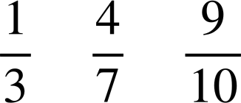

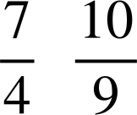

Efficiently calculating a single multiplier
Here are some numbers connected multiplicatively using 1 as the middle step. Work out the single multiplier that connects each number.
×
×
×
8
a)
1
3
8
3
24
8
8
×
×
×
5
b)
1
5
24
8
5

Slide 33
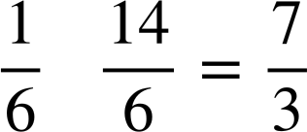

Efficiently calculating a single multiplier
Work out the single multiplier between 8 and 15.
Work out the single multiplier between 6 and 14.
×
×
×
×
14
15
6
1
2
8
1
8
14
2
8
15
The multiplier is
The multiplier is

Slide 34
Efficiently calculating a single multiplier
Here are some numbers connected multiplicatively using 1 as the middle step. Work out the single multiplier that connects each number.
×
×
×
a)
1
3
5
3
24
8
5
×
×
×
b)
1
6
24
8
6
×
×
×
c)
5
1
5
2
24
8
2

Slide 35
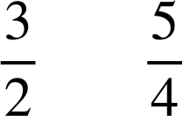

Efficiently calculating a single multiplier
2) Write the number in the box to make the calculation correct.
a)
8 × 2 = 16
c)
8 × = 10
b)
d)
8 × = 12
8 × = 9

Slide 36
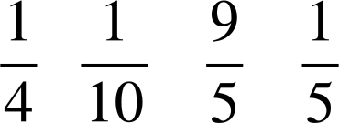
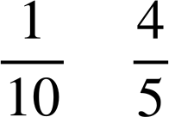
Efficiently calculating a single multiplier
3) Fill in the blanks.
×
×
×
9
a)
9
1
24
8
9
×
×
×
b)
1
8
24
8

Slide 37
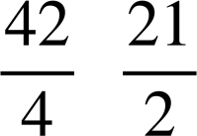
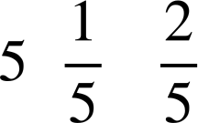
Efficiently calculating a single multiplier
Here are some numbers connected multiplicatively using 1 as the middle step. Work out the single multiplier that connects each number.
×
×
×
5
a)
1
3
5
3
24
8
5
×
×
×
6
b)
1
6
24
8
6
×
×
×
2
c)
5
1
5
2
24
8
2

Slide 38
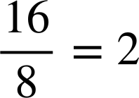
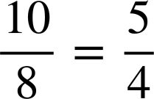
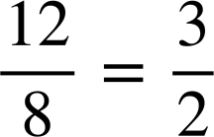
Efficiently calculating a single multiplier
2) Write the number in the box to make the calculation correct.
a)
8 × 2 = 16
c)
8 × = 10
Multiplier
Multiplier
×
×
×
×
16
10
8
1
16
8
1
10
2
8
2
8
b)
d)
8 × = 12
8 × = 9
Multiplier
×
×
×
12
×
9
8
1
12
2
8
8
1
9
2
8

Slide 39
Efficiently calculating a single multiplier
3) Fill in the blanks.
×
×
×
9
a)
1
4
9
4
24
8
9
×
×
×
8
b)
10
1
10
8
24
8
8

Slide 40
Multiplicative relationships
There exists a multiplier for any pair of values.
Multiplying a number by its reciprocal will always have a product of 1, which can then be used with a multiplier to connect 1 to another number.
The multiplicative relationship can be shown in multiple steps, where the single multiplier is the product of the multipliers.

Slide 41

© Oak National Academy 2024.
Produced in partnership with Mathematics in Education and Industry.
Licensed on the Open Government Licence v3.0, except where otherwise stated. See Oak terms and conditions.

